Slide 1

José Luis Urbano Orgaz
Sistemas de Información
Máster en Ingeniería Informática
Universidad de Extremadura

Slide 2
Apache Spark
Cluster computing framework
Open Source
Interface for programming clusters with implicit data parallelism and fault-tolerance.

Slide 3
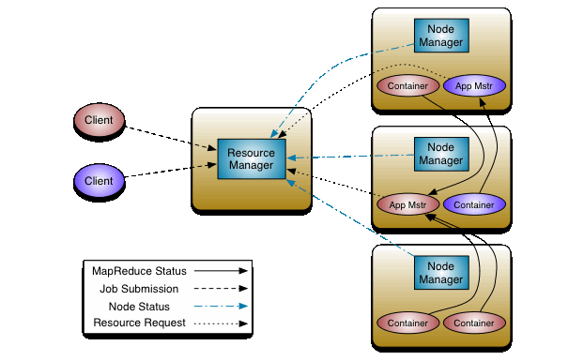
Apache Spark

Slide 4
Cluster manager
Manages and configure a set of services
Dispatches work for the cluster to perform
Spark supports standalone, Hadoop YARN, and Apache Mesos.

Slide 5
Distributed storage system
Spark can interface with a wide variety, including Hadoop Distributed File System (HDFS), MapR File System (MapR-FS), Cassandra, OpenStack Swift, Amazon S3, Kudu...

Slide 6
Requirements
Java JRE
Scala
SSH
Hadoop precompiled Apache Spark

Slide 7
JAVA 8
sudo apt-get update
sudo apt-get upgrade
sudo apt-get update
sudo apt-add-repository ppa:webupd8team/java
java -version
sudo apt-get install oracle-java8-installer

Slide 8
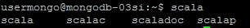
Scala
wget http://downloads.lightbend.com/scala/2.11.8/scala-2.11.8.deb
sudo dpkg -i scala-2.11.8.deb

Slide 9
Download Apache Spark
wget http://apache.rediris.es/spark/spark-1.6.1/spark-1.6.1-bin-hadoop2.6.tgz
tar -zxvf spark-1.6.1-bin-hadoop2.6.tgz

Slide 10
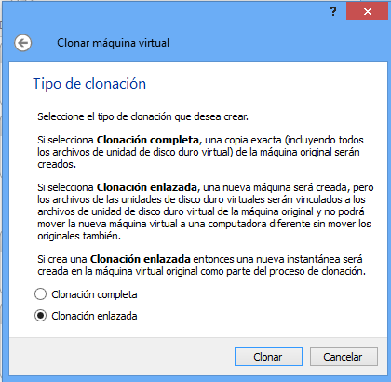
Clone virtual machine
Power off virtual machine
Clone virtual machine

Slide 11
SSH
Slave node
sudo apt-get install openssh-server
Master node
ssh-keygen
Pending task:
ssh-copy-id -i ~/.ssh/id_rsa.pub jose@192.168.56.102

Slide 12
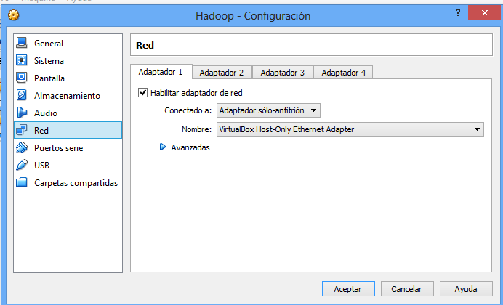
Internal network
Modify network adapter: VirtualBox Host-Only Ethernet Adapter
Configure network interface
Master
sudo ifconfig eth0 192.168.56.101
Slave
sudo ifconfig eth0 192.168.56.102
Ping each other

Slide 13
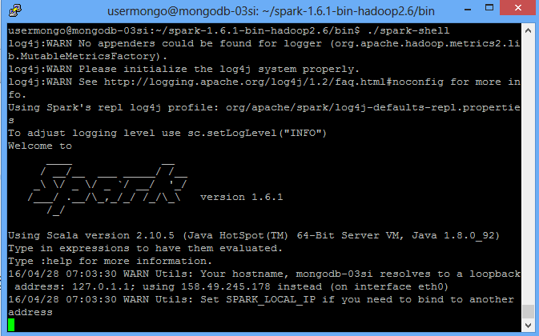
Pending tasks list
Master node
ssh-copy-id -i ~/.ssh/id_rsa.pub jose@192.168.56.102
Both nodes
./spark-shell

Slide 14
Configuration
Both nodes at conf directory:
mv slaves.template slaves
Add slave ip (192.168.56.102)
mv spark-env.sh.template spark-env.sh
Add:
export SPARK_MASTER_IP=192.168.56.101
export SPARK_WORKER_CORES=1
export SPARK_WORKER_MEMORY=2000m
export SPARK_WORKER_INSTANCES=2
mv log4j.properties.template log4j.properties
Replace “INFO” alert level by “WARN” to avoid useless info

Slide 15
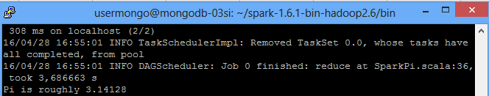
Local testing
At /bin:
./run-example SparkPi

Slide 16
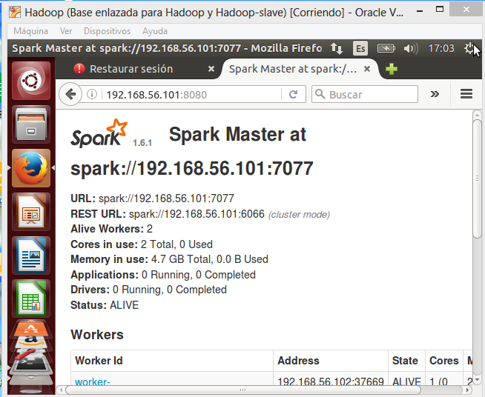
Cluster testing
At /sbin:
./start-all.sh

Slide 17
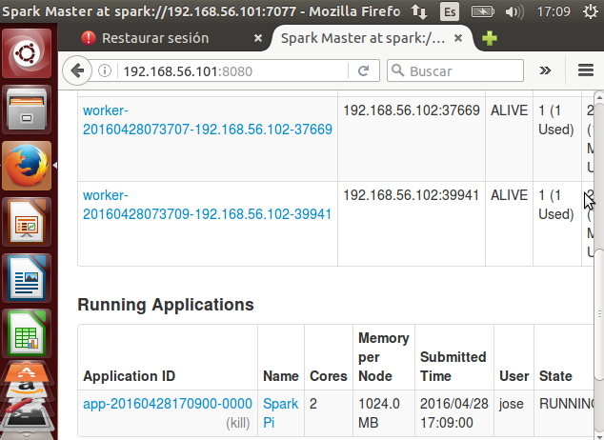
Run distributed example
At /bin:
MASTER=spark://192.168.56.101:7077 ./run-example SparkPi

Slide 18
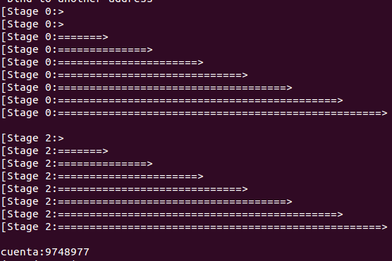
Python example
Copy script and data
At /bin:
MASTER=spark://192.168.56.101:7077 ./spark-submit script.py

